Slide 1
Visualizing Deployed Models with R Shiny and Watson Machine Learning — Greg Filla Offering Manager, Watson Data Platform

Slide 2
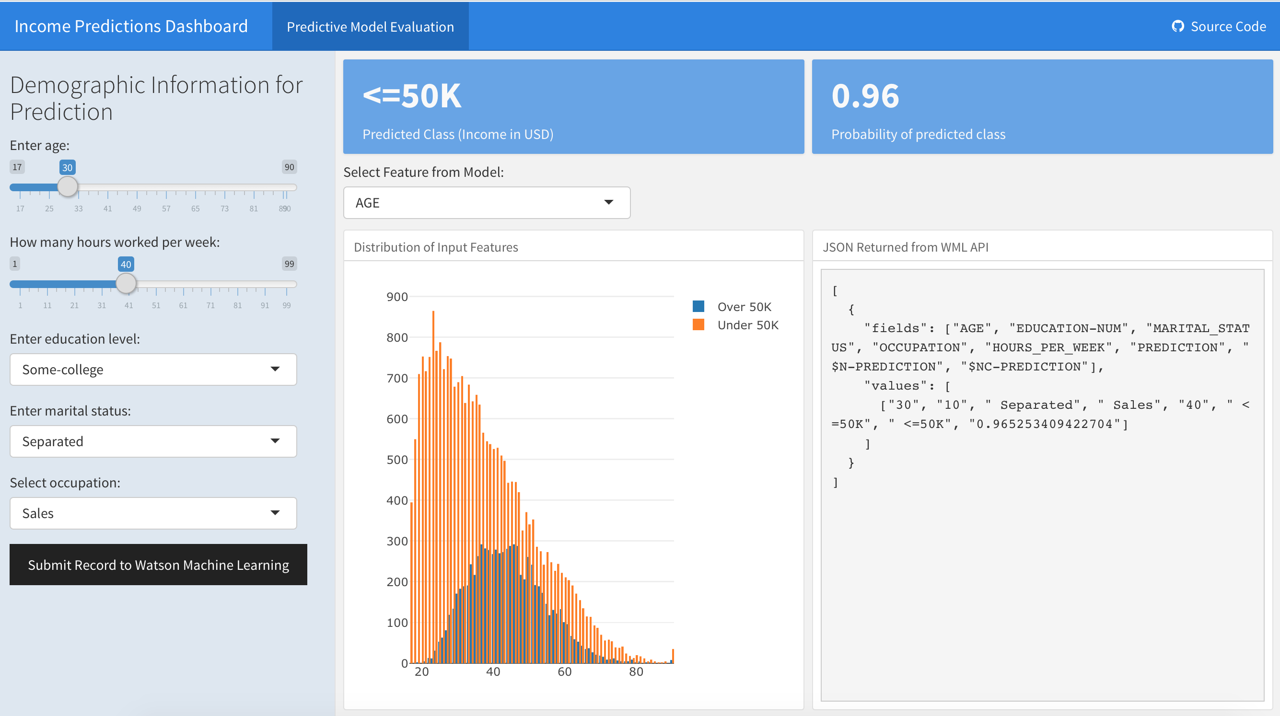
What we will build today:

Slide 3
Stages of the lab
Data Collection
Data Exploration and Model Building
Model Deployment
Dashboard implementation

Slide 4
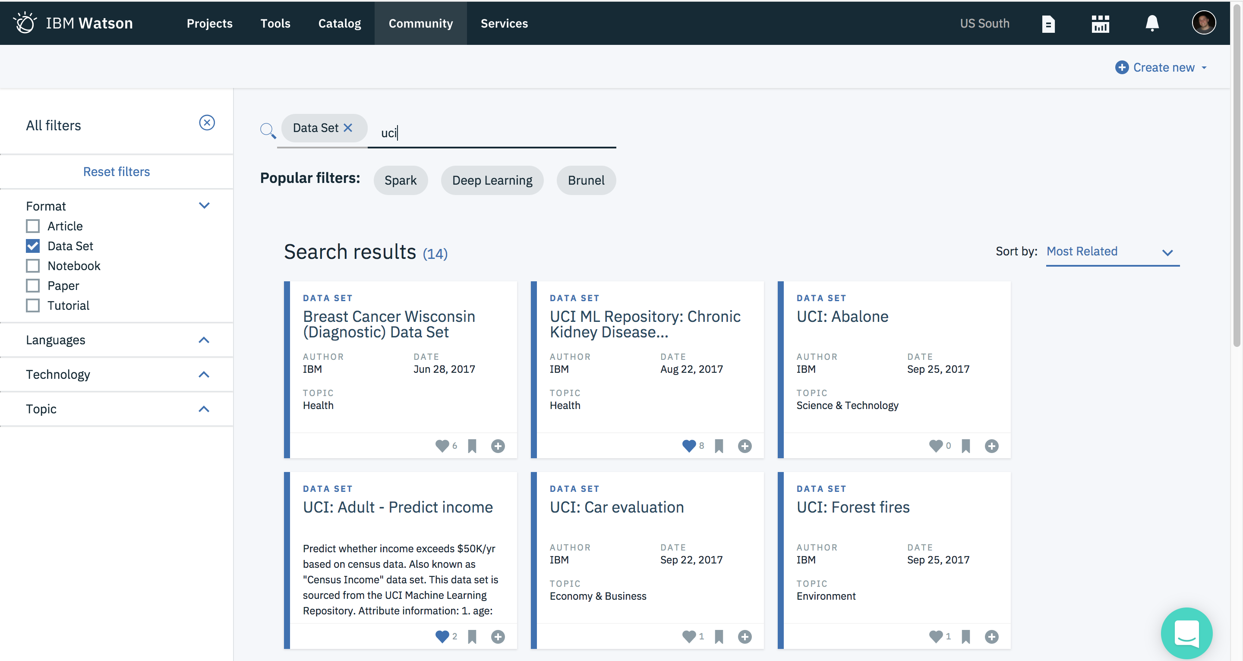
Data Collection:

Slide 5
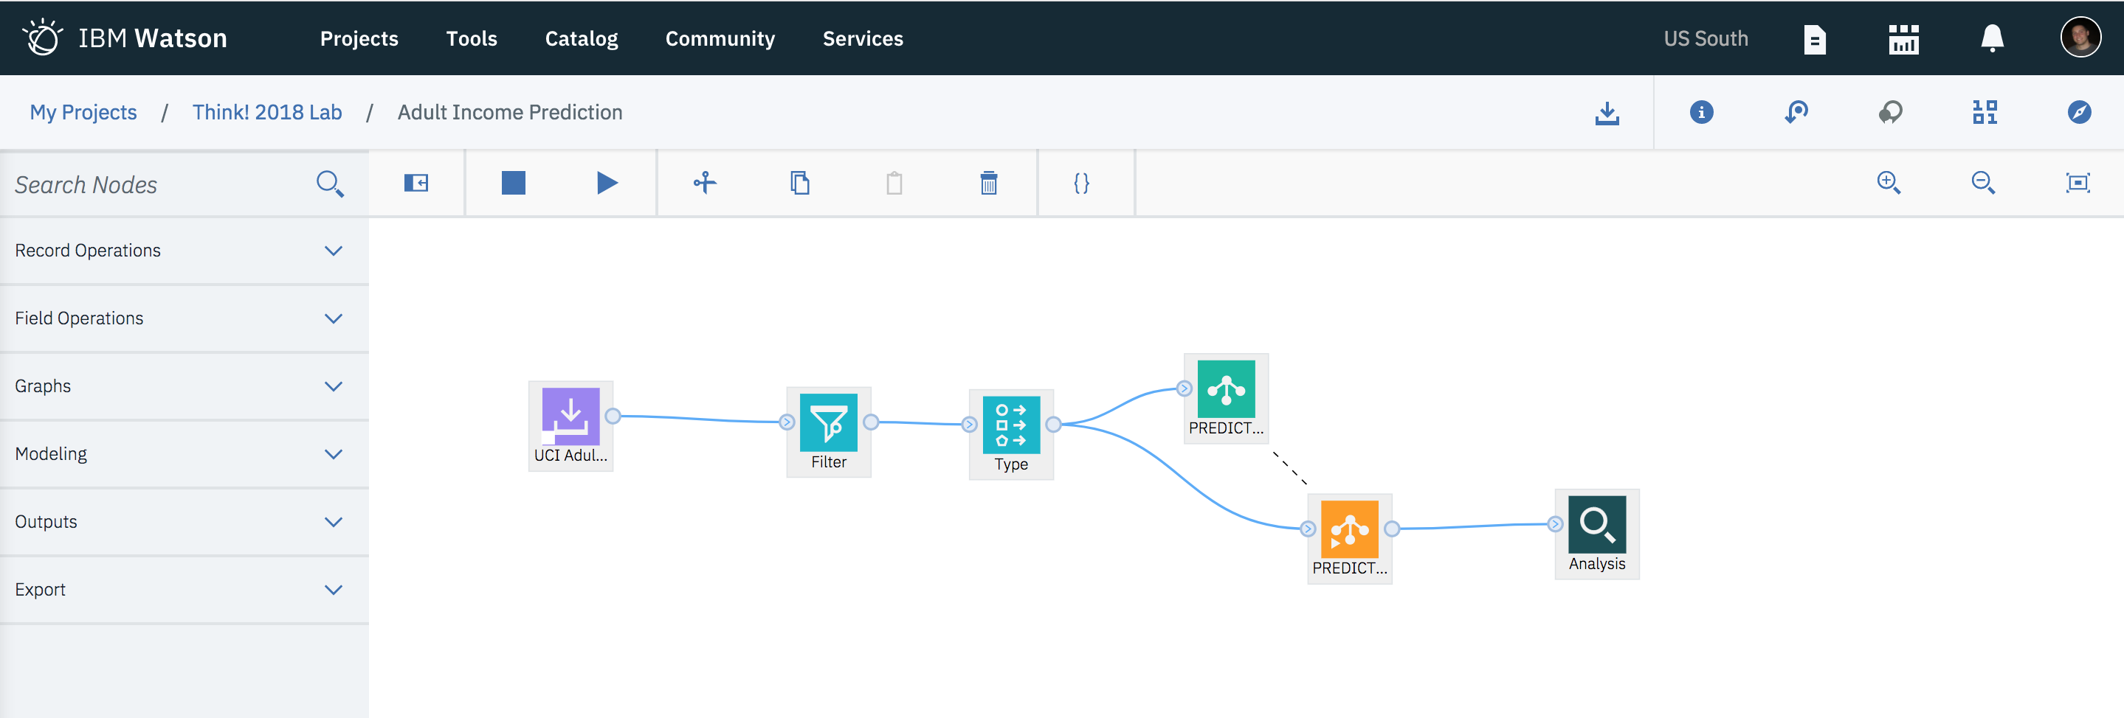
Model Building in SPSS Modeler in Watson Studio:

Slide 6
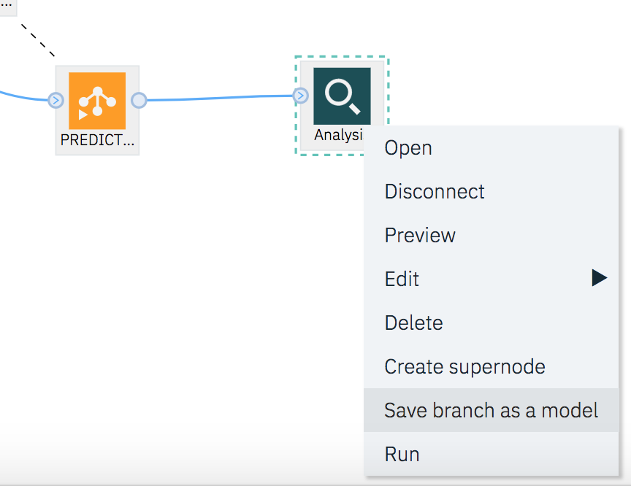
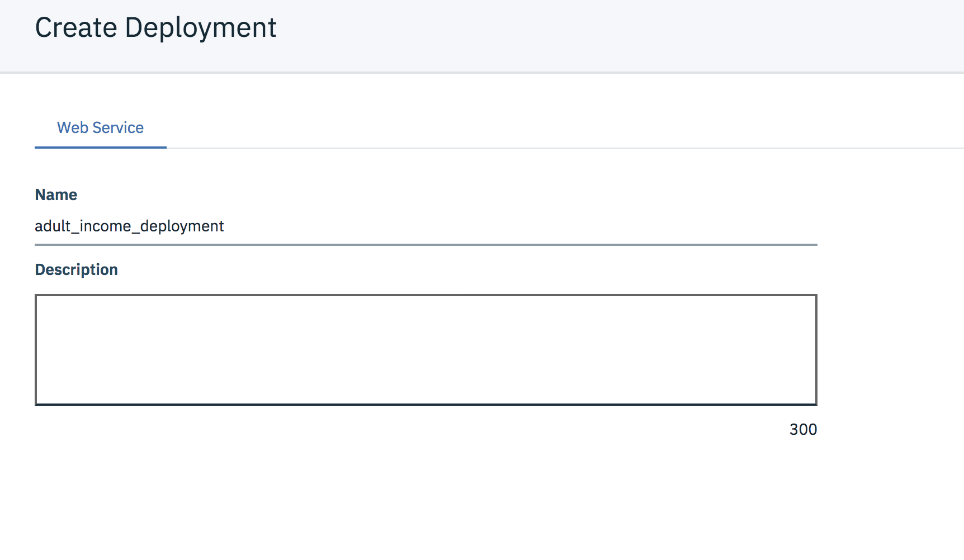
Deploying the model with Watson Machine Learning:

Slide 7
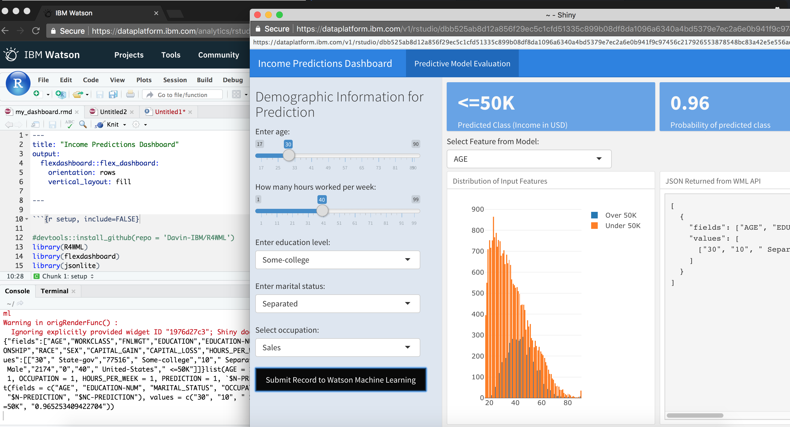
Creating a Shiny Dashboard with RStudio:

Slide 8
Important concepts for this lab
Democratizing model building and deployment
Cross-functional collaboration
Rapid experimentation

Slide 9
Fundamentals of R Shiny

Slide 10

What is R Shiny?
Web app framework
Uses only R code to build interactive web applications
Open source project created by RStudio
Why use Shiny?
Provides quick way to go from analysis in R to interactive applications
Offers more flexibility than commercial BI tools
Share your analysis easily via URL
How to get started?
Very easy if you already have Rstudio (just installing an R package)
Many tutorials online
Flexdashboard is an easier way to get started with Shiny
Shiny Questions Answered

Slide 11
Shiny Application Architecture
R Scripts
R Scripts
R Scripts
Cached Data
Web Server
Web Browser
Web Browser
Web Browser
~Shiny~
Data Sources

Slide 12
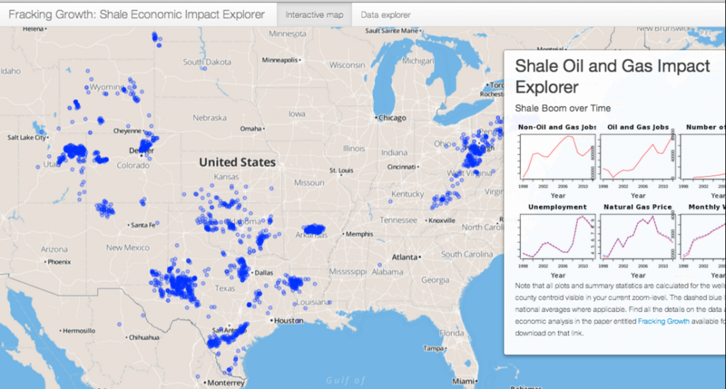
Shiny: the good / the bad
Pros
Open source and free to use
Works well for small/med data sets
Many R packages available for viz**
Flexible framework for development
Bound by limits of what is possible with code
Build apps with only R
Cons
Not great for big data
Limiting if custom visualizations are needed
Requires some R skills
Requires a Shiny Server to deploy

Slide 13
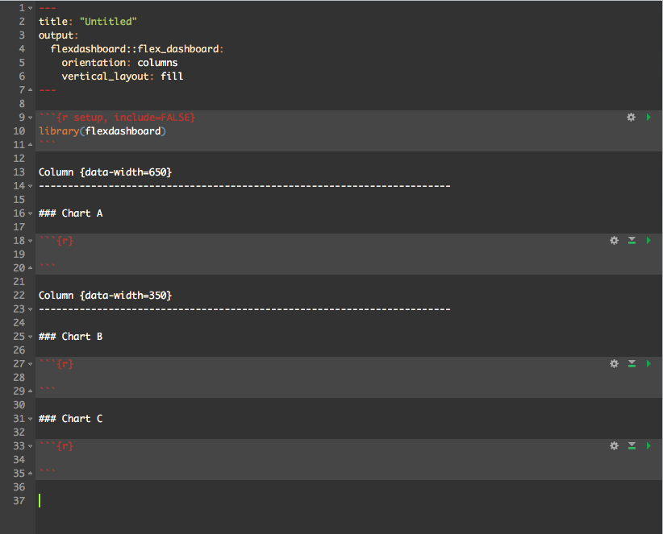
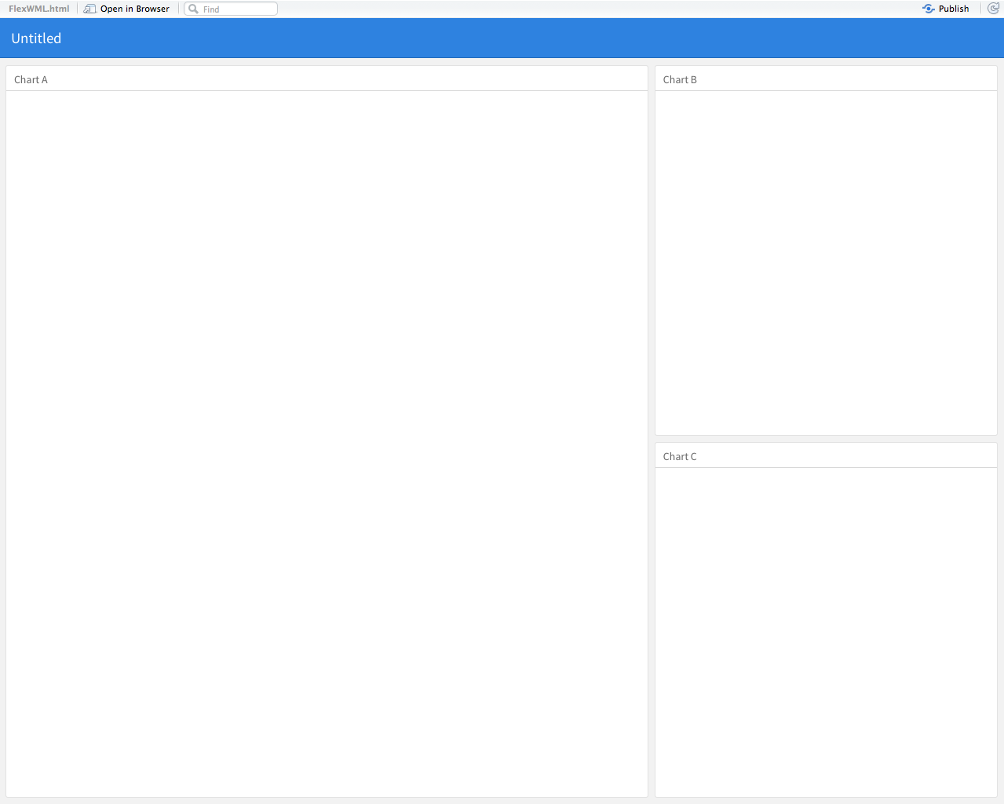
Flexdashboard Document Overview
Header Nav: configured at the top of the doc
Column 1:
1 placeholder
Column 2:
2 section placeholder

Slide 14
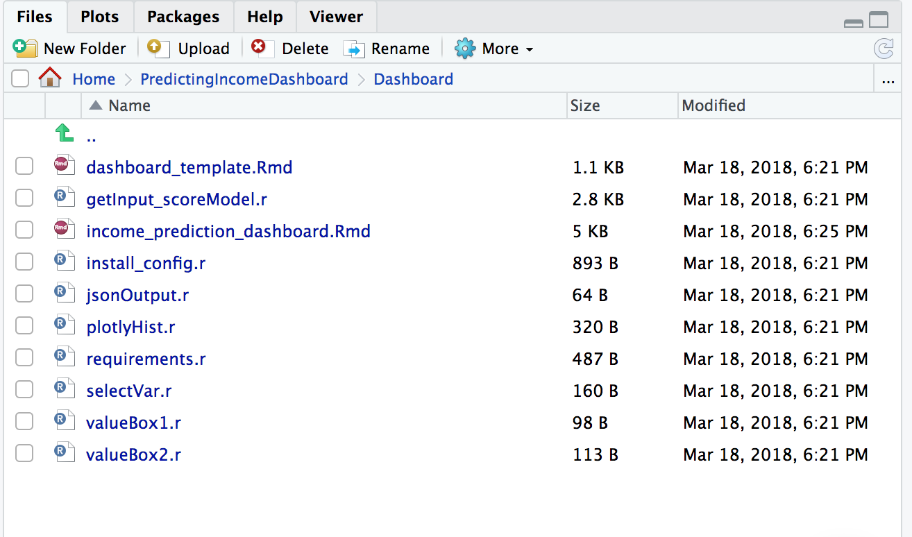
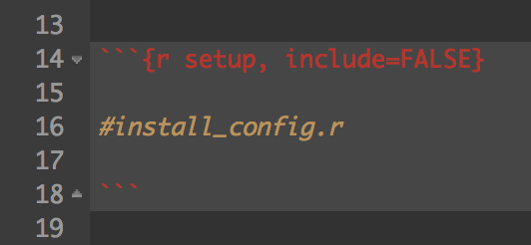
Filling in the template
Open the dashboard_template.Rmd file
Open the R scripts in this folder to paste in the template
3. At any point – you can view the dashboard by executing:
rmarkdown::run("PredictingIncomeDashboard/Dashboard/income_prediction_dashboard.Rmd")

Slide 15
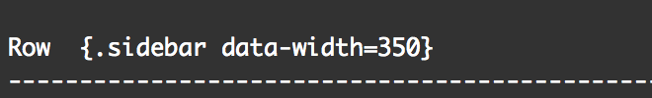
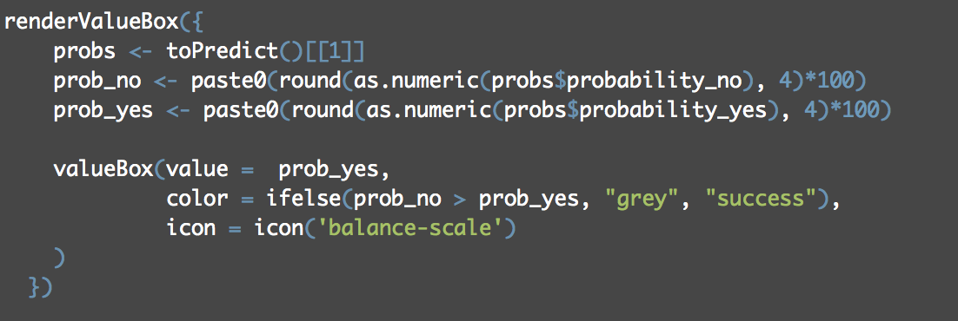
Component Breakdown (1)
Sidebar
Value Boxes

Slide 16
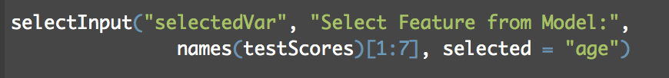
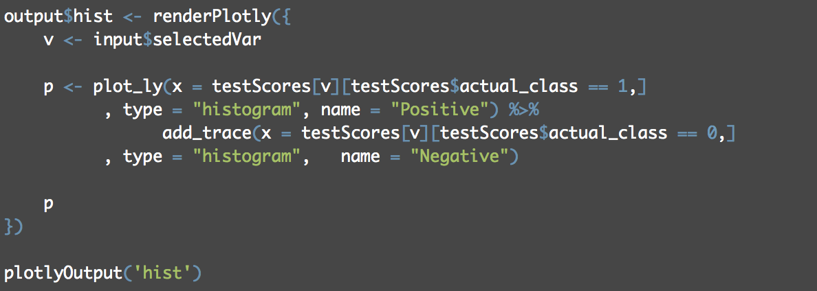
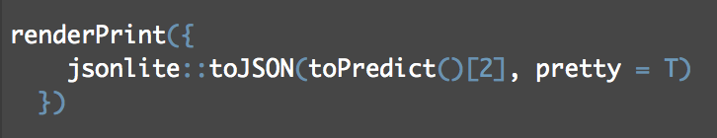
Component Breakdown (2)
Plotly Visualization
User Input
Plotting code
Print JSON

Slide 17
Component Breakdown (1)
Plotly Visualization
User Input
Plotting code
Print JSON

Slide 18
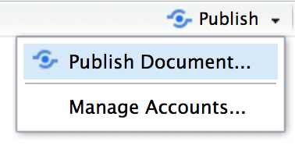
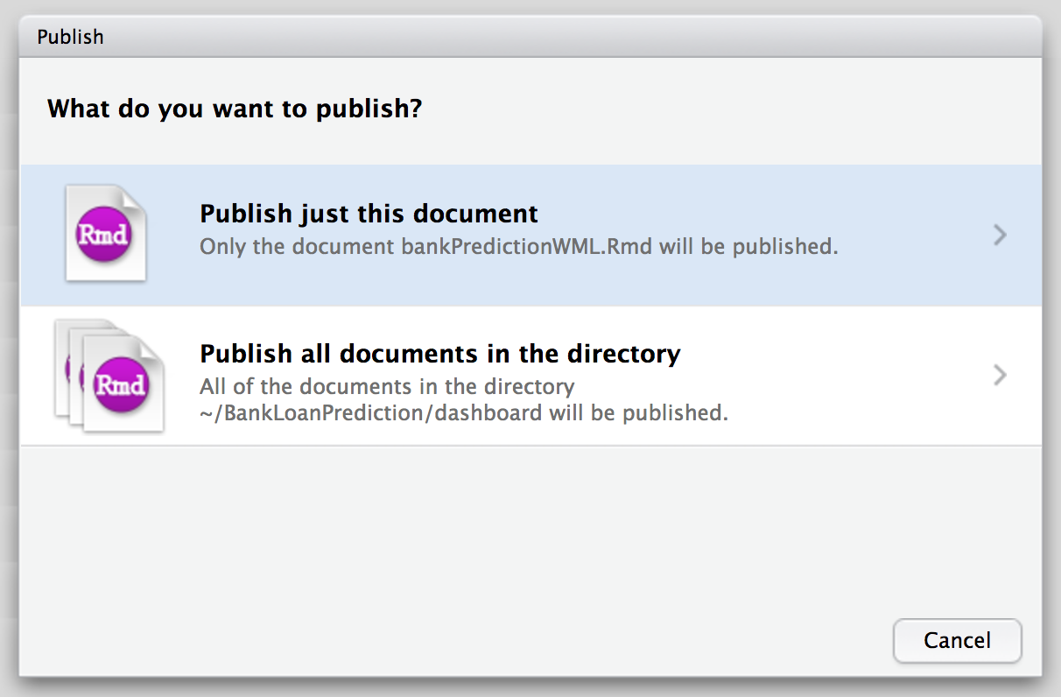
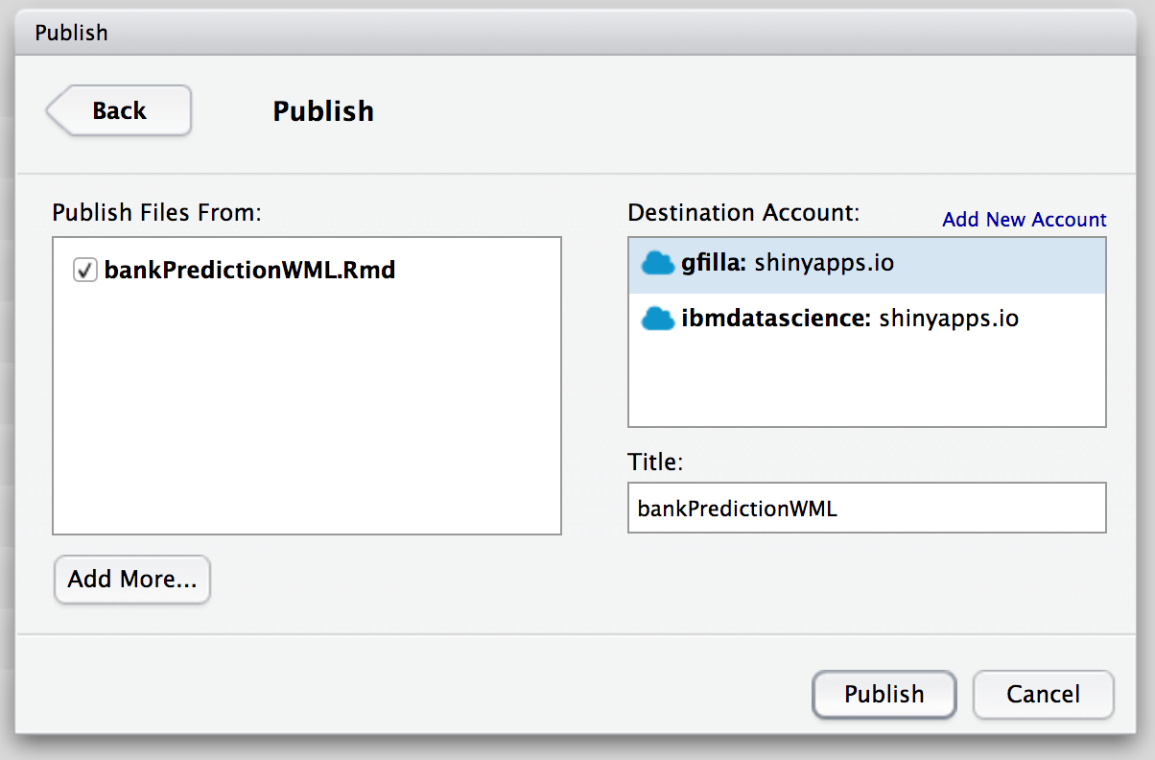
Deploying on Shinyapps.io
This is in the top right when viewing the dashboard

Slide 19
To complete the lab, go to: https://github.com/gfilla/PredictingIncomeDashboard

